Slide 1
OESON Data Science
Image Processing Project
Oscar Bowie
Data Science Batch-2023

Slide 2
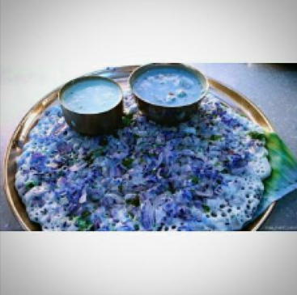
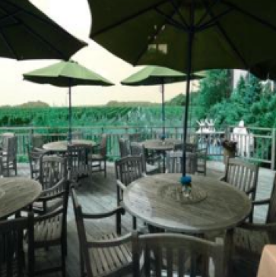
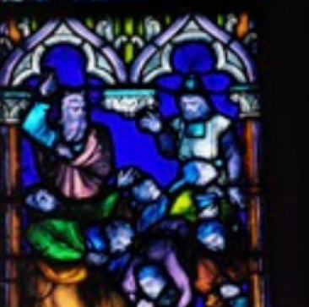
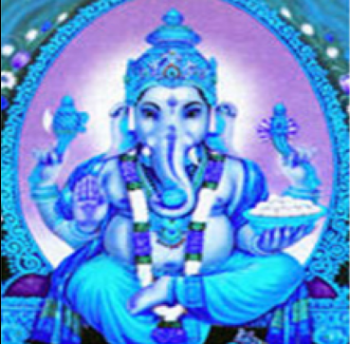
Introduction
This project explores a vast dataset of a popular photo studio— a collection of diverse photographs by different photographers. In this project, we will be analyzing this massive dataset, and creating a machine learning model to categorize the images into 4 classes. As such, the machine learning model of choice for this type of processing is a Convolutional Neural Network (CNN). This investigation will be undertaken primarily using the Keras and SKLearn libraries.

Slide 3
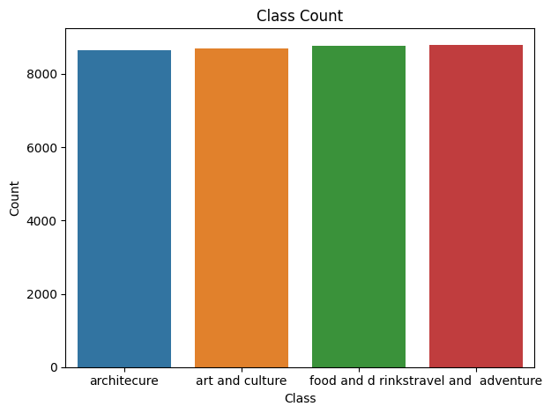
Dataset
Dataset initially consisted of a directory with 4 folders, with each folder containing 1 class. These folders, containing images of varying sizes was read into an array as a (224, 224, 3) numpy array, resizing oversized images where necessary. These were then arranged with their class into the data array.
While reading, 167/35095 images threw an error, which were discarded, as this was about 0.5% of the whole dataset.

Slide 4
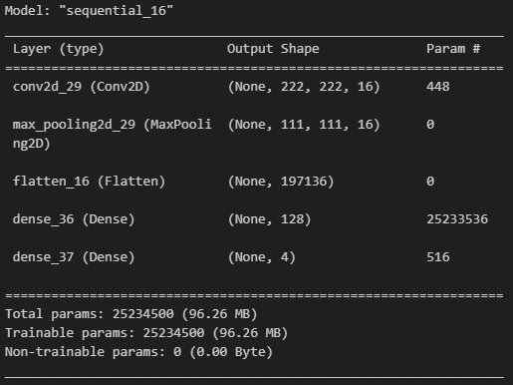
Model 1
Initial model tried on a small subset of the whole dataset (4000 entries). Was a simple model consisting of 1 convolution layer, into 1 dense layer.
This simple model was used to get a baseline, and to vary and compare the output opposed to changes to this base model.

Slide 5
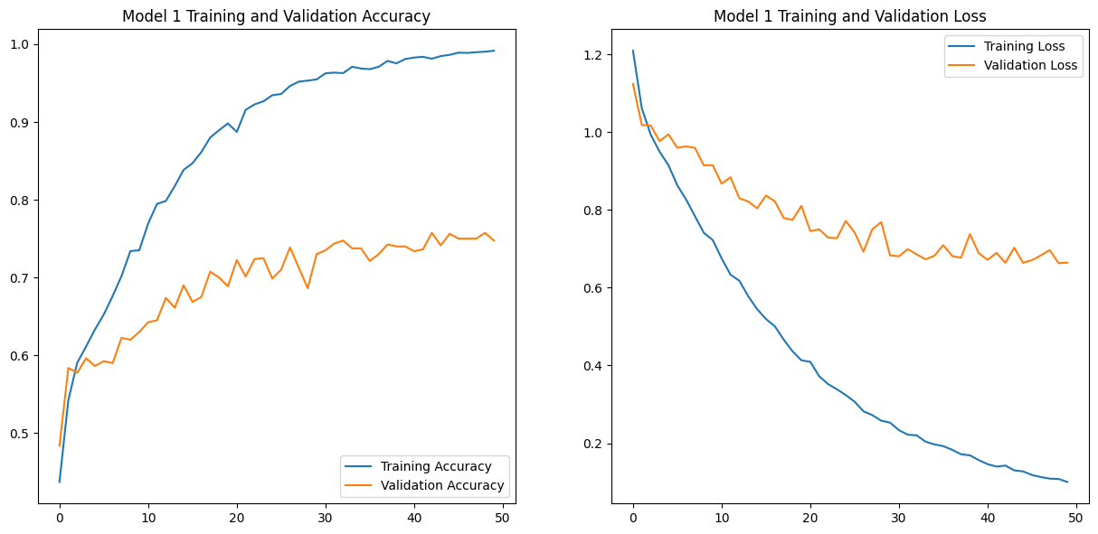
Model 1 Accuracy

Slide 6
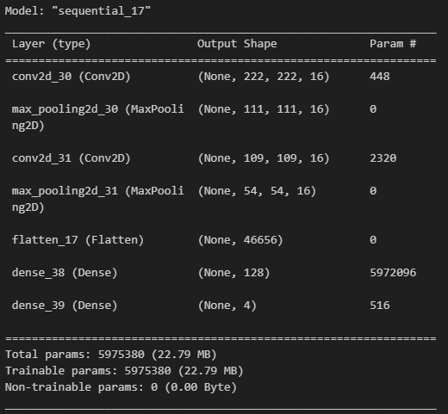
Model 2
Model 2 built on model 1 with the addition of another convolution layer, for a total of 2 convolution layers, and 1 dense layer.
However, it was found that this model was outperformed on the same dataset by model 1.

Slide 7
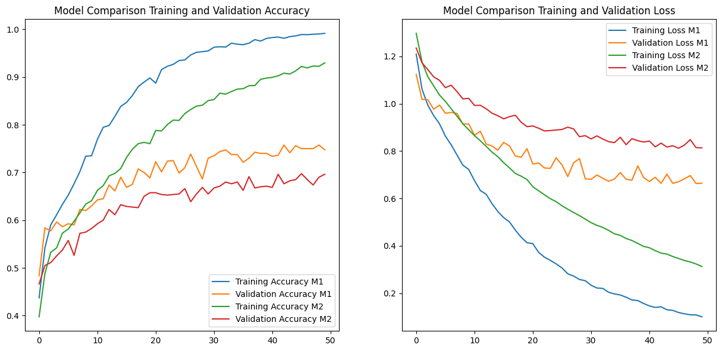
Model 2 Accuracy and Comparison

Slide 8
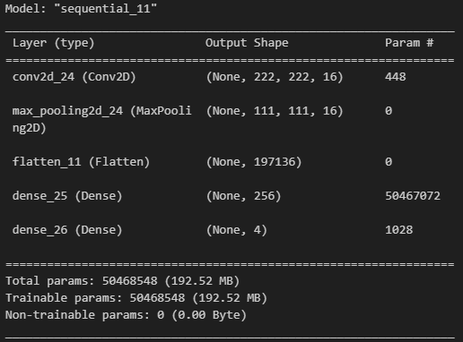
Model 3
Model 3 instead tried to improve on model 1 upping the number of neurons in the dense layer, for a total of 1 convolution layer, into 1 dense layer with 256 neurons.
This was found to perform about as well as the first model with the exception of having a larger loss, so model 1 was preferred.

Slide 9
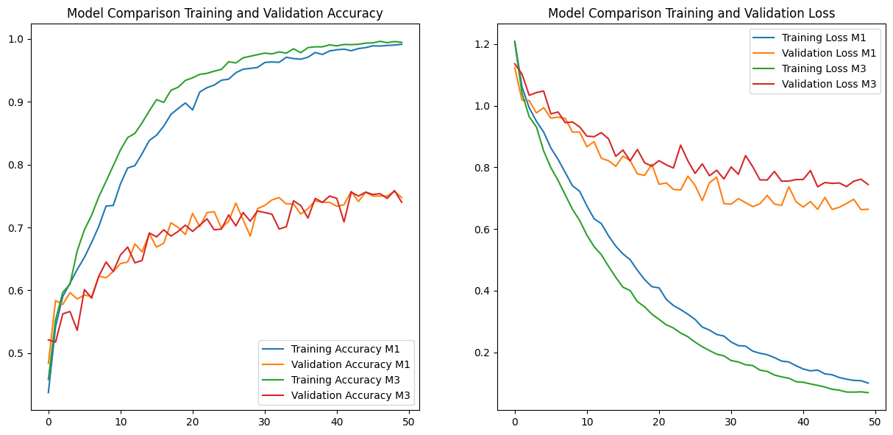
Model 3 Accuracy and Comparison

Slide 10
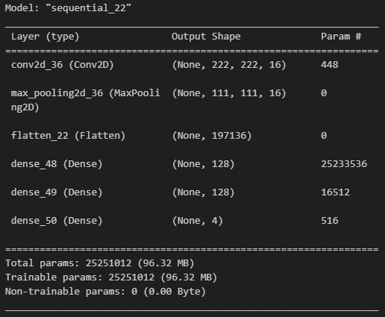
Model 4
Model 4 instead added an additional dense layer to model 1, for a total of 1 convolution layer, and 2 dense layers (of the same size).
However, model 4 was also outperformed by model 1, with higher loss and lower accuracy.

Slide 11
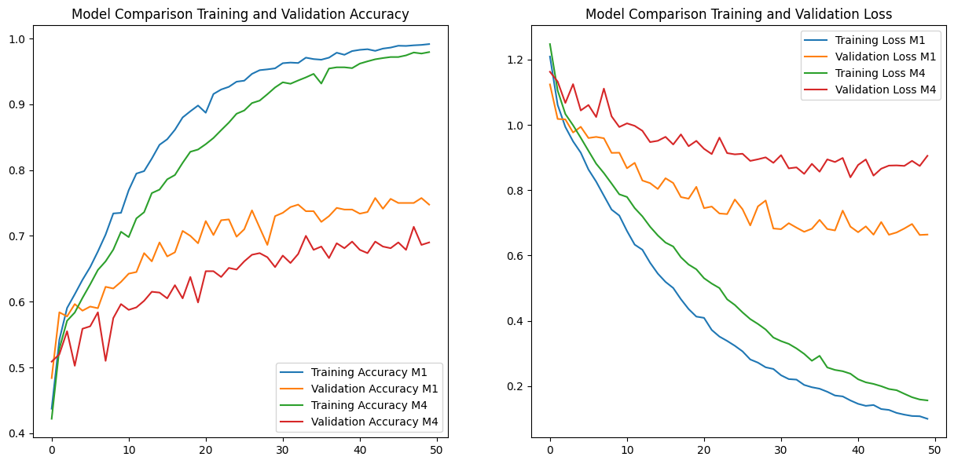
Model 4 Accuracy and Comparison

Slide 12

Model 5
Model 5 increased the number of filters on the convolution from 16 to 32, and left everything else untouched, for a total of 1 convolution layer (32 instead of 16 filters), and 1 dense layer.
Model 5 performed similarly to model 1, with a slightly lower accuracy, and a slightly higher loss.

Slide 13
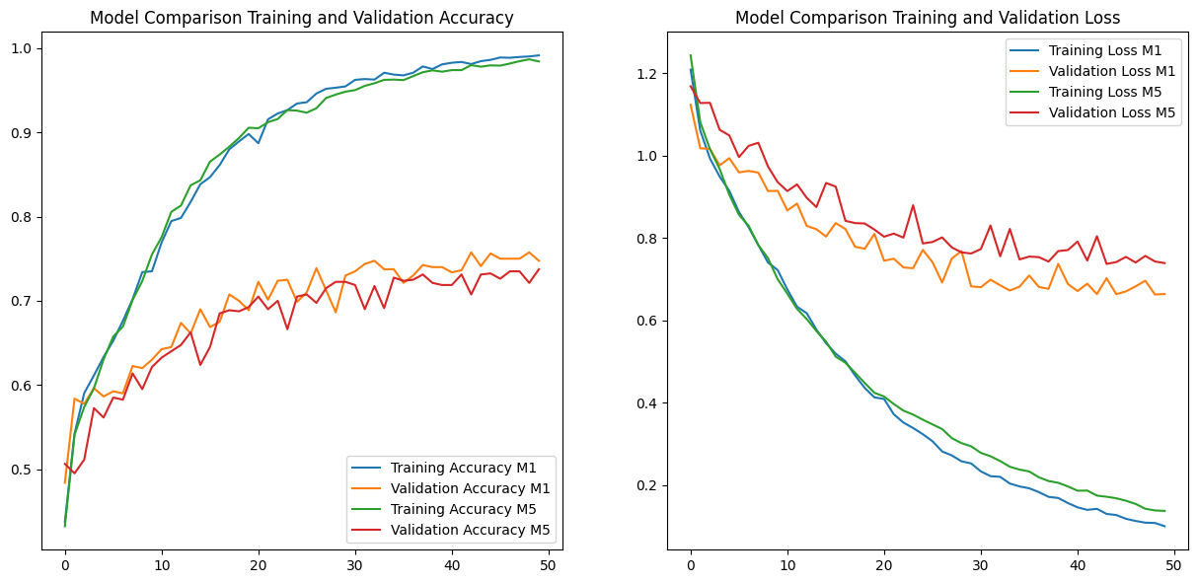
Model 5 Accuracy and Comparison

Slide 14
Model 1 Medium Training Data
From this point, tweaking the model seemed to bring down the accuracy in most scenarios, so model 1 was run on a training set of 8000 data points instead of 4000 to see if accuracy improved.

Slide 15
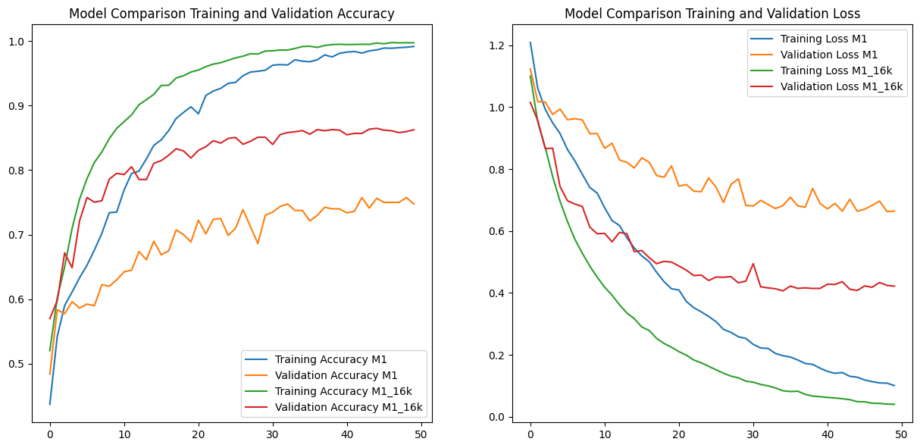
Model 1 (M) Accuracy and Comparison

Slide 16
Model 1 Large Training Data
Accuracy improved drastically from 4000 samples to 8000 samples, so this was doubled again to 16000 and model 1 was trained again.
This yielded an accuracy of ~86%.

Slide 17
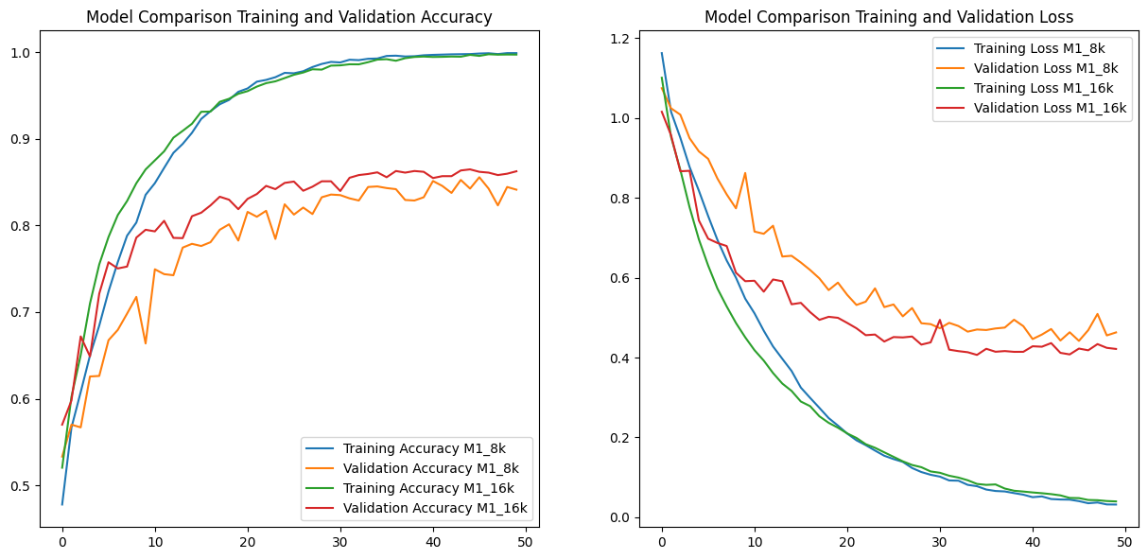
Model 1 (L) Accuracy and Comparison

Slide 18
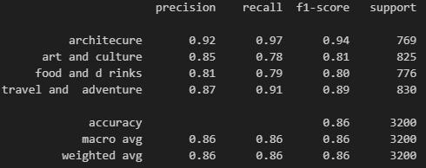
Conclusion
Model 1 on the 16000 training set had an overall accuracy of ~86%. It classified correctly most on architecture images, followed by travel and adventure, then art and culture, then food and drinks, with fairly similar precision and recall scores. This could be further improved using additional data, however the resources required to train were unavailable at the time of testing.

